Slide 1
ECE 532
CHAPTER 5: SEARCH AND SORTING (PART 1: LINEAR SEARCH, BINARY SEARCH)
Lecturer: Dr. Roslina Mohamad
Room: Tower 2, Level 13, No:14C

Slide 2
Learning Outcomes
In this chapter, you will:
Learn the various search algorithms
Implement sequential and binary search algorithms
Compare sequential and binary search algorithm performance

Slide 3
Introduction
Using a search algorithm, you can:
Determine whether a particular item is in a list
If the data is specially organized (for example, sorted), find the location in the list where a new item can be inserted
Find the location of an item to be deleted

Slide 4
Searching and Sorting Algorithms
Data can be organized with the help of an array or a linked list
unorderedLinkedList
unorderedArrayListType

Slide 5
Search Algorithms
Key of the item
Special member that uniquely identifies the item in the data set
Key comparison: comparing the key of the search item with the key of an item in the list
Can count the number of key comparisons

Slide 6
An Example
Imagine we have a database of students
I want to know if Bob Smith is in my class.
I want to search my database and have the module print out “IN THE CLASS” or “NOT IN THE CLASS.”

Slide 7
Another Situation
I have the same student database.
I need to view Alice Jones’ grades and update them.
Again, I need to search the database.
This time, I need Alice’s information returned to me so I can view and modify them (i.e. need access).

Slide 8
The Scenario
We have some collection (stored in an array, tree, or list)
May be sorted or not
May be empty or not
We want the determine if a particular element is in the collection or not.
We need to search for the element.

Slide 9
Searching
Given the collection and an element to find…
Determine whether the “target” element was found in the collection
Print a message
Return a value (an index or pointer, etc.)
Don’t modify the collection in the search!

Slide 10
Key Fields
Often, our collections will hold complex structures (i.e. have many items of information in each).
It is common to organize our collection using one “part” (or field)
Name
Student Number
This is called the “key field”
Then we can search on the key field.

Slide 11
A Simple Search
A search traverses the collection until
The desired element is found
Or the collection is exhausted
If the collection is ordered, I might not have to look at all elements
I can stop looking when I know the element cannot be in the collection.

Slide 12
Searching in an Unordered Collection (Linear Search)
Let’s determine if the value 12 is in the collection:
Head
35
42
12
5
\\
12 Found!

Slide 13
Searching in an Unordered Collection (Linear Search)
Let’s determine if the value 13 is in the collection:
Head
35
42
12
5
\\
13 Not Found!

Slide 14
Searching in an Ordered Collection (Binary Search)
Let’s determine if the value 13 is in the collection:
Head
5
12
35
42
\\
13 Not Found!

Slide 15
Search Examples
Arrays
Linked Lists
Binary Trees

Slide 16
Sequential/Linear Search
Sequential search (linear search):
Same for both array-based and linked lists
Starts at first element and examines each element until a match is found
Our implementation uses an iterative approach
Can also be implemented with recursion

Slide 17
Sequential Search Analysis
Statements before and after the loop are executed only once
Require very little computer time
Statements in the for loop repeated several times
Execution of the other statements in loop is directly related to outcome of key comparison
Speed of a computer does not affect the number of key comparisons required

Slide 18
Linear Search
Collection of data items to be searched is organized in a list x₁, x₂, … x_{n}
Assume = = and < operators defined for the type
Linear search begins with item 1
continue through the list until target found
or reach end of list

Slide 19
Sequential Search
bool LinSearch(double x[ ], int n, double item){
for(int i=0;i<n;i++){
if(x[i]==item) return true;
else return false;
}
return false;
}
Example 5.1, Example 5.2, Example 5.3

Slide 20

Sequential/Linear Search Analysis
L: a list of length n
If search item (target) is not in the list: n comparisons
If the search item is in the list:
As first element of L → 1 comparison (best case)
As last element of L → n comparisons (worst case)
Average number of comparisons:

Slide 21



Search Algorithms
Suppose that there are n elements in the array. The following expression gives the average number of comparisons:
It is known that
Therefore, the following expression gives the average number of comparisons made by the sequential search in the successful case:

Slide 22
Search Algorithms

Slide 23
Binary Search
Usually outperforms a linear search
Disadvantage:
Requires a sequential storage
Not appropriate for linked lists (Why?)
It is possible to use a linked structure which can be searched in a binary-like manner

Slide 24
Binary Search (Refer to chapter Recursion : Recursive Binary Search)
Binary search can be applied to sorted lists
Uses the “divide and conquer” technique
Compare search item to middle element
If search item is less than middle element, restrict the search to the lower half of the list
Otherwise restrict the search to the upper half of the list

Slide 25
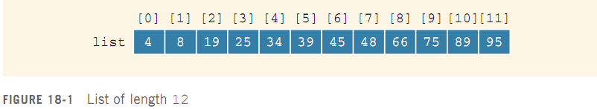
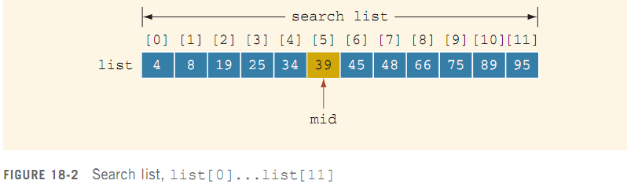
Binary Search

Slide 26
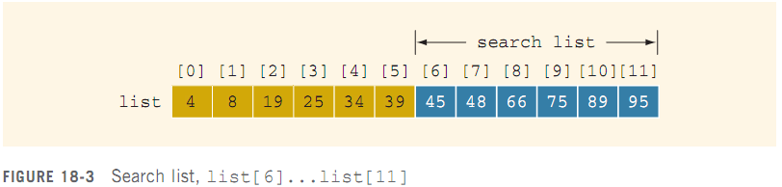
Binary Search
Search for value of 75:

Slide 27
Performance of Binary Search
Every iteration cuts size of the search list in half
If list L has 1024 = 2¹⁰ items
At most 11 iterations needed to find x
Every iteration makes two key comparisons
In this case, at most 22 key comparisons
Max # of comparisons = 2log₂n+2
Sequential search required 512 key comparisons (average) to find if x is in L

Slide 28
Asymptotic Notation: Big-O Notation
After an algorithm is designed, it should be analyzed
May be various ways to design a particular algorithm
Certain algorithms take very little computer time to execute
Others take a considerable amount of time

Slide 29
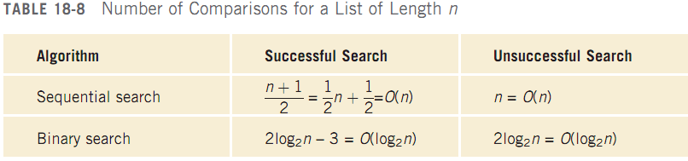
Asymptotic Notation: Big-O Notation
We can use Big-O notation to compare sequential and binary search algorithms:

Slide 30
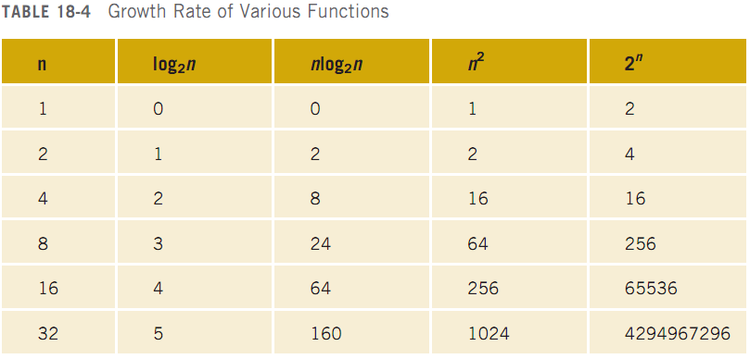
Asymptotic Notation: Big-O Notation (cont’d.)

Slide 31
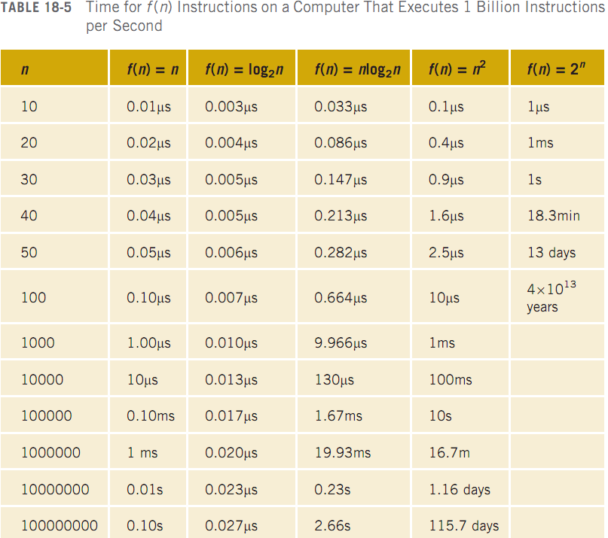
Asymptotic Notation: Big-O Notation (cont’d.)

Slide 32
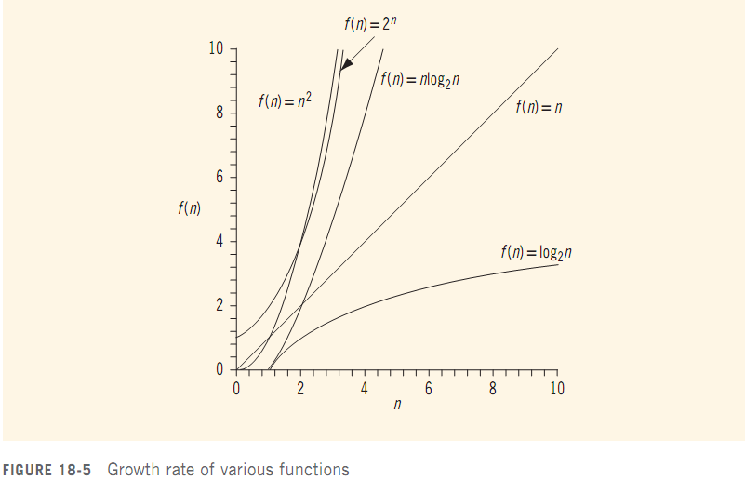
Asymptotic Notation: Big-O Notation (cont’d.)

Slide 33
Asymptotic Notation: Big-O Notation (cont’d.)
Let f be a function of n
Asymptotic: the study of the function f as n becomes larger and larger without bound
Let f and g be real-valued, non-negative functions
f(n) is Big-O of g(n), written f(n)=O(g(n)) if there are constants c and n₀ such that
f(n)≤cg(n) for all n ≥n₀

Slide 34
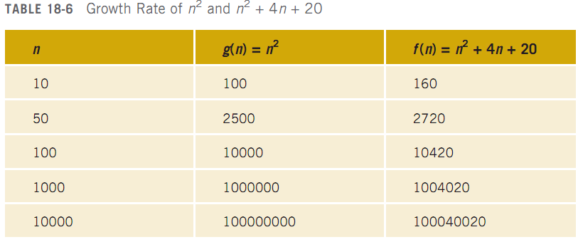
Asymptotic Notation: Big-O Notation (cont’d.)

Slide 35
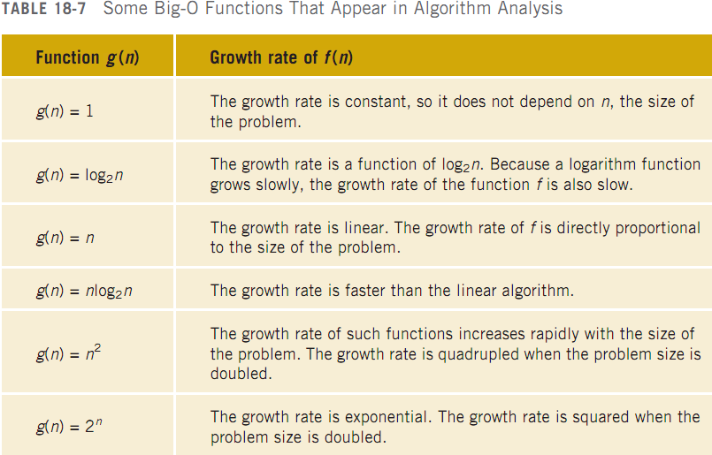
Asymptotic Notation: Big-O Notation (cont’d.)

Slide 36
Summary
On average, a sequential search searches half the list and makes O(n) comparisons
Not efficient for large lists
A binary search requires the list to be sorted
2log₂n – 3 key comparisons
Let f be a function of n: by asymptotic, we mean the study of the function f as n becomes larger and larger without bound

Slide 37
Summary (cont’d.)
Binary search algorithm is the optimal worst-case algorithm for solving search problems by using the comparison method
To construct a search algorithm of the order less than log₂n, it cannot be comparison based

